Slide 1
WELCOME CVPR 2016 LAS-VEGAS

Slide 2
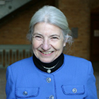
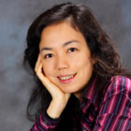
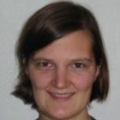
3 GENERAL CHAIRS
Ruzena Bajcsy
Fei-Fei Li
Tinne Tuytelaars

Slide 3
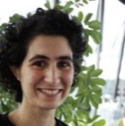
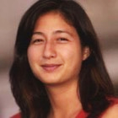
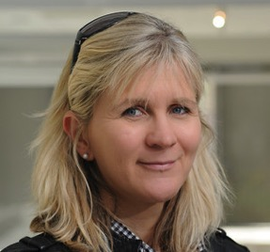
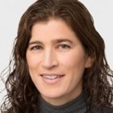
4 PROGRAM CHAIRS
Lourdes Agapito
Tamara Berg
Jana Kosecka
Lihi Zelnik-Manor

Slide 4
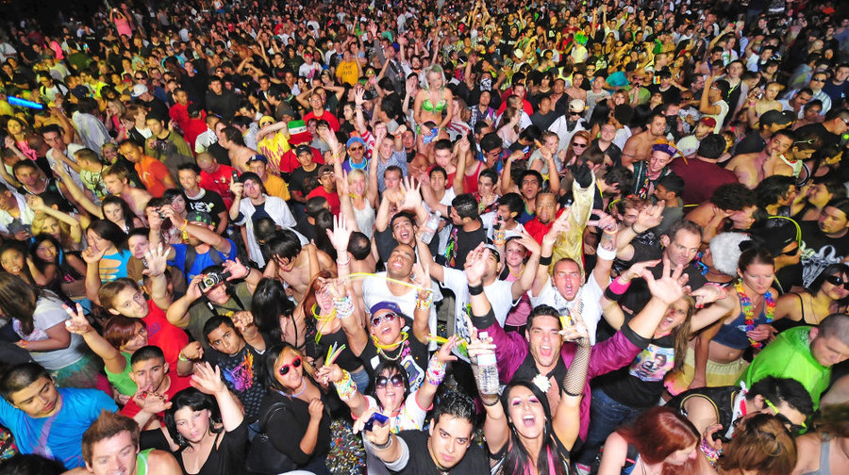
3609 ATTENDEES

Slide 5
100 COMPANIES

Slide 6
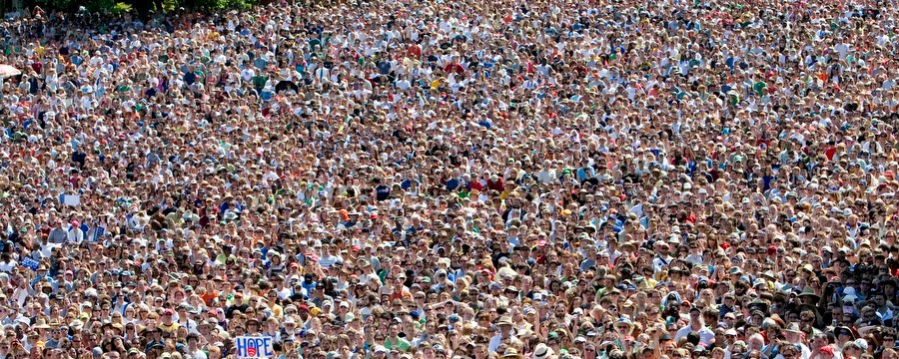
>6000 AUTHORS

Slide 7
1141 REVIEWERS

Slide 8
72 AREA-CHAIRS

Slide 9
4 PROGRAM CHAIRS

Slide 10
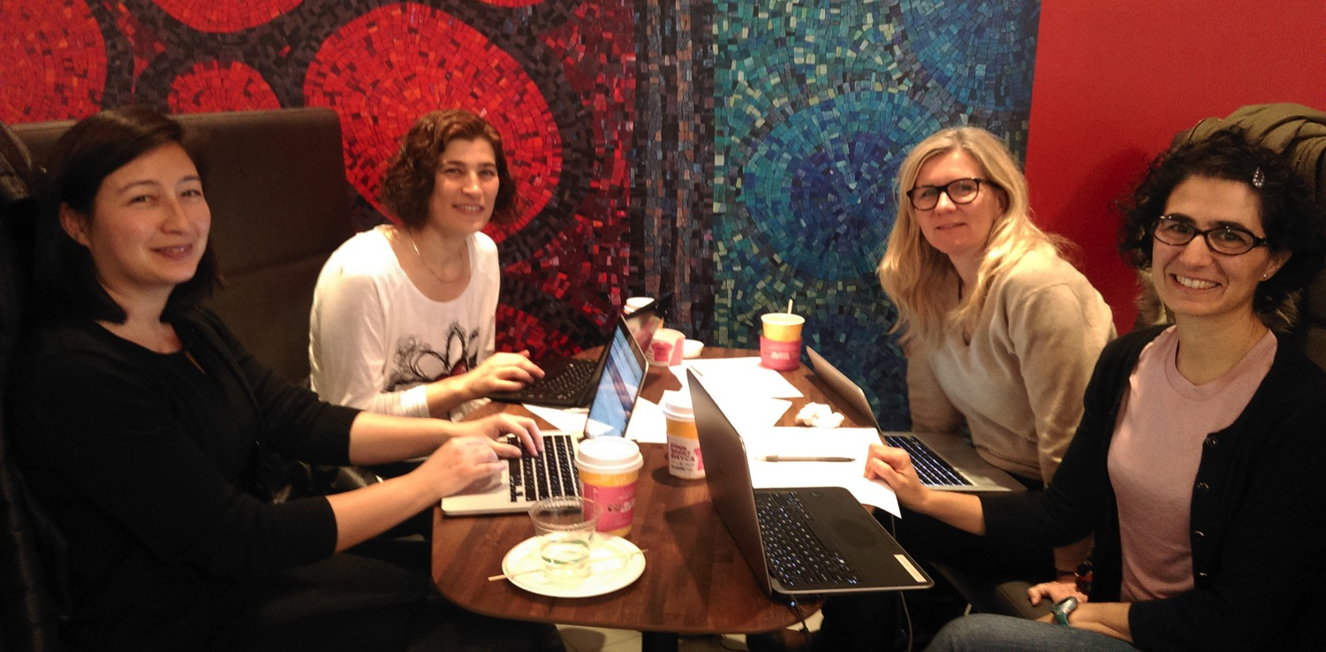
Yet, we still smile ☺
PCs at work in the Area-Chair meeting

Slide 11
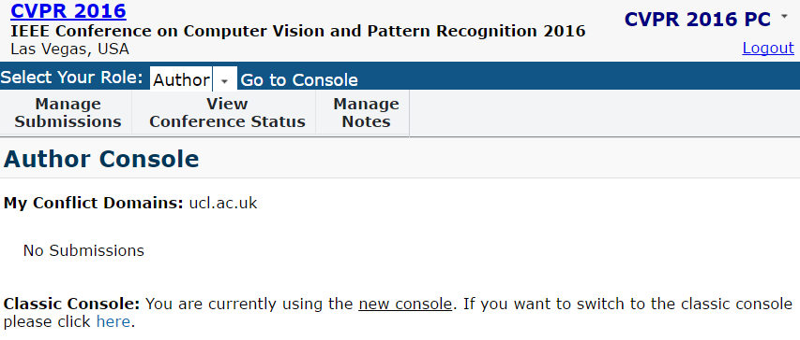
The life of a CVPR16 paper
Welcome to CMT!

Slide 12
The life of a CVPR16 paper
All authors MUST enter their conflict information
1800 authors without conflict domains after submission deadline
PCs send a polite email
Your paper is about to be REJECTED
1000 authors without conflict domains
PCs send a scary email
300 authors without conflict domains

Slide 13
The life of a CVPR16 paper
AC bid on papers
I want this paper!
Area-Chair

Slide 14
The life of a CVPR16 paper
AC bid on papers
AC suggest candidate reviewers
I know who should review it
Area-Chair
70% of papers assigned ≥ 2 reviewers of top 3 candidates
All assigned reviewers were amongst candidates suggested by the Area-Chairs

Slide 15
The life of a CVPR16 paper
AC bid on papers
AC suggest candidate reviewers
3 experts review each paper

Slide 16
Review progress statistics
Before the deadline

Slide 17
The life of a CVPR16 paper
AC bid on papers
AC suggest candidate reviewers
3 experts review the paper
3 AC discuss the paper
HELP
NO
YES

Slide 18
The life of a CVPR16 paper
AC bid on papers
AC suggest candidate reviewers
3 experts review the paper
3 AC discuss the paper
12 panels discuss Orals and Spotlights

Slide 19
2145 SUBMISSIONS

Slide 20
643 ACCEPTED

Slide 21
123 SPOTLIGHTS

Slide 22
83 ORALS

Slide 23
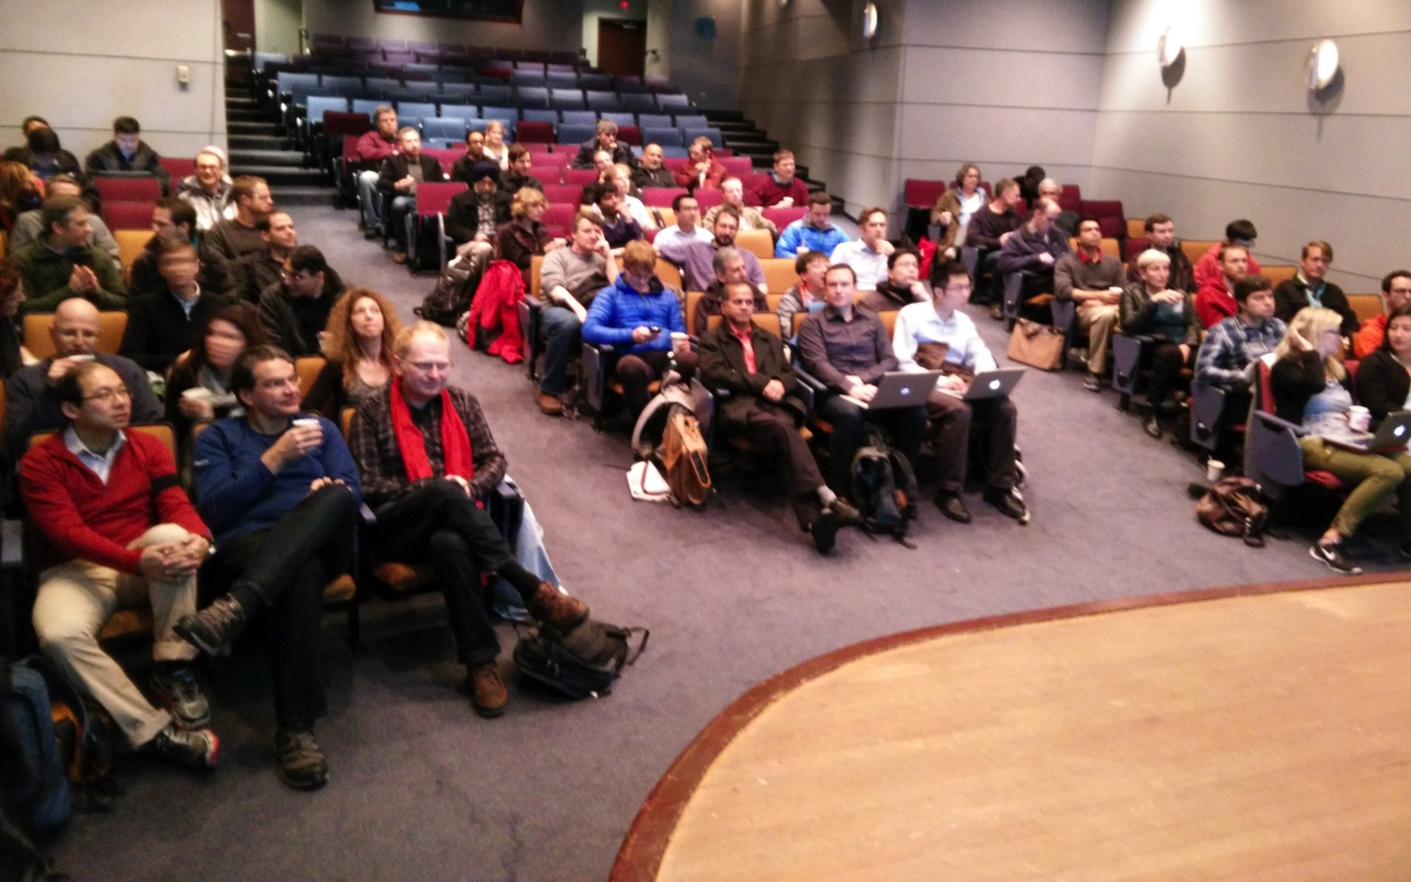
Thanks to the wonderful Area Chairs!!

Slide 24
Computer vision is booming

Slide 25
Computer vision is booming

Slide 26
Topic Trends

Slide 27
SPOTLIGHTS – NEW to CVPR16
Short oral presentations
Expose more papers to the broad audience
No questions after spotlights - discussions only at the posters.
(Also for Long Orals – discussions at posters)

Slide 28
CVPR 2016 celebrates
Coming of Age of computer vision
We promised:
Increased presence and interactions between Industry and Academia
We delivered:
Expo with over 80 companies!!
Online job fair on website
32 Live demos

Slide 29
CVPR 2016 celebrates
Next generation researchers
We promised:
Increased financial support to students
Increased presence of women
We delivered:
56 travel grants (students and young researchers)
Second WiCV workshop (Women in Computer Vision)
Organizing committee with women majority
Child care facilities

Slide 30
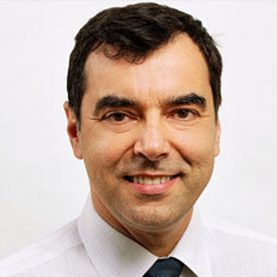
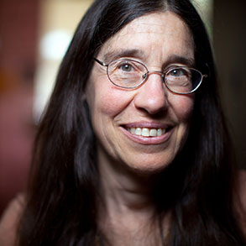
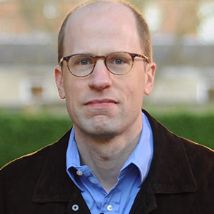
Invited Speakers
Amnon Shashua
Liz Spelke
Nick Bostrom

Slide 31
Some instructions
Please DO NOT download proceedings during the conference (WIFI will die….)
Oral room B is smaller → overflow room (Emperor) with video projection
posters can be presented at in Palace I
No social event on Wednesday evening
AM
PM
PM
AM

Slide 32
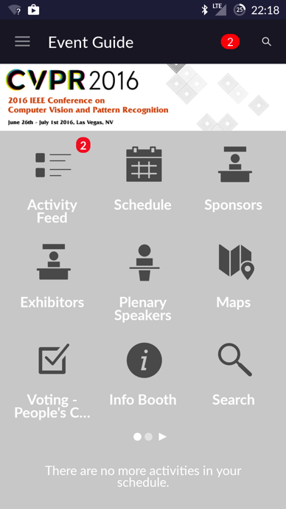
People’s Choice Award
Please VOTE through the CPS APP or CVPR 2016 website

Slide 33
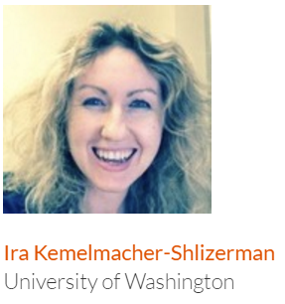
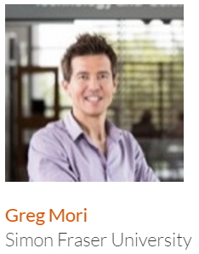
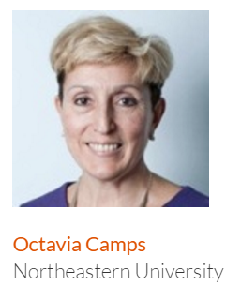
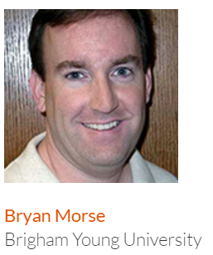
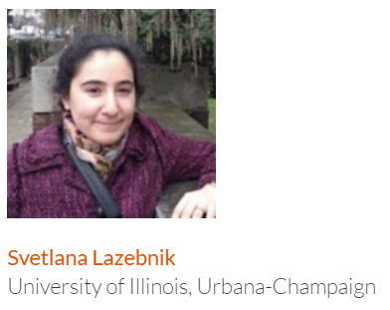
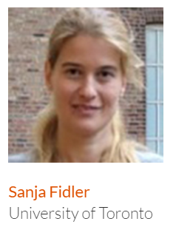
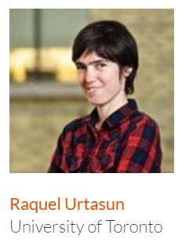
Our Chairs did an amazing job!!
Thank you all!!

Slide 34
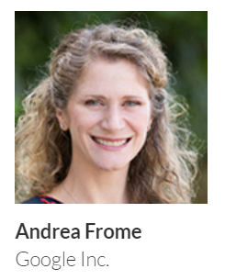
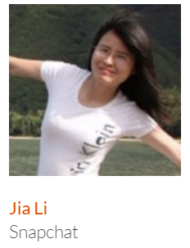
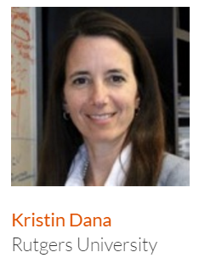
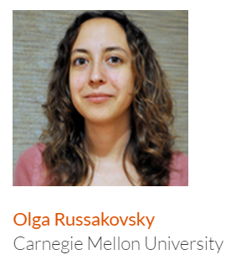
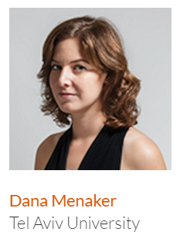
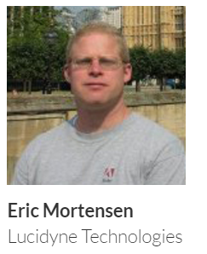
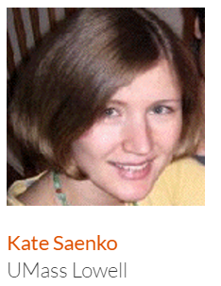
Our Chairs did an amazing job!!
Thank you all!!

Slide 35
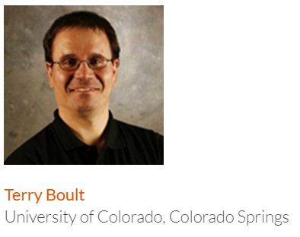
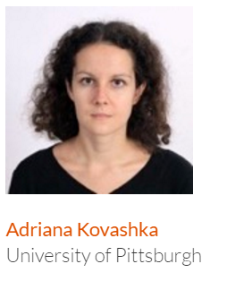
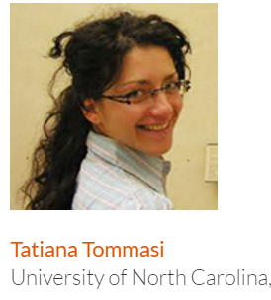
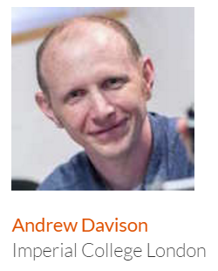
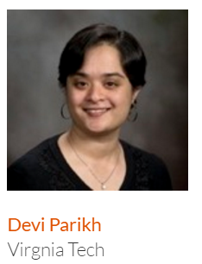
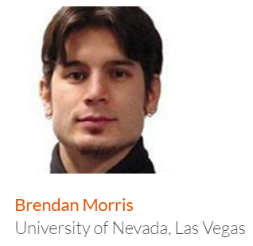
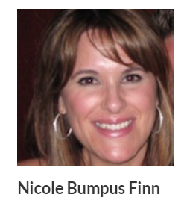
Our Chairs did an amazing job!!
Thank you all!!

Slide 36
WELCOME CVPR 2016 LAS-VEGAS

